Slide 1

Introduction to Neural Networks
Presented by:
Elizer Ponio Jr.
Department of Computer Science
College of Computing and Information Technologies

Slide 2
Outline
What is a Neural Network?
How does a Neural Network make a prediction?
How to train a Neural Network

Slide 3
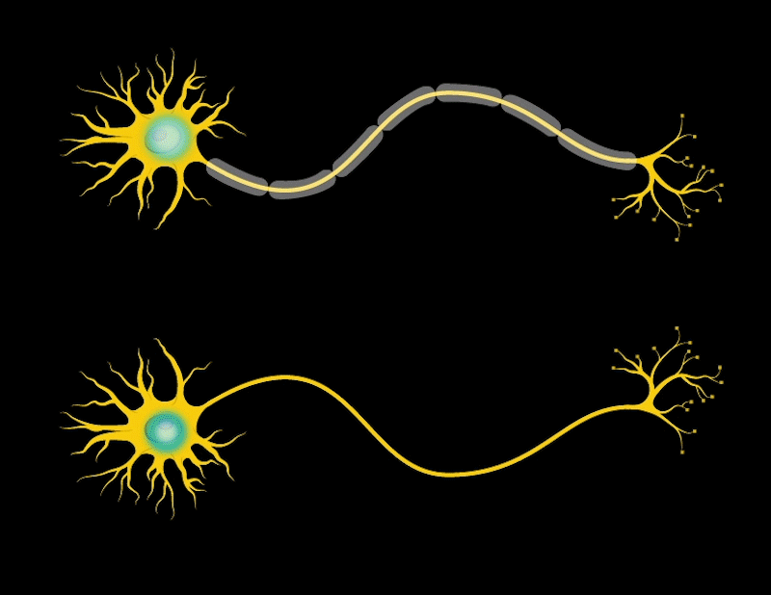
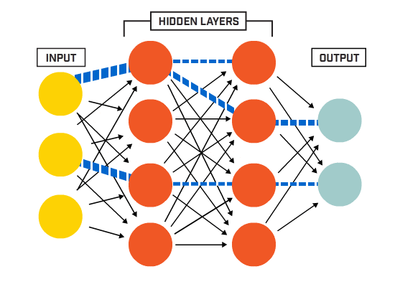
Neural Networks
Also known as artificial neural networks (ANNs) are a subset of machine learning and are at the heart of deep learning algorithms.
Their name and structure are inspired by the human brain, mimicking the way that biological neurons signal to one another.

Slide 4
Neural Networks
It is comprised of layers of neurons or nodes, containing an input layer, one or more hidden layers, and an output layer.

Slide 5
Neuron
Neuron
Neuron
Neuron
Neuron
Input Layer
Hidden Layer
Output Layer

Slide 6
Input Layer
This is where the network receives its input data. Each input neuron in the layer corresponds to a feature in the input data.

Slide 7


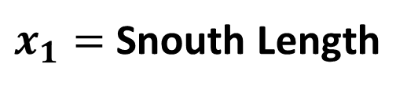
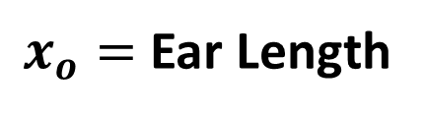
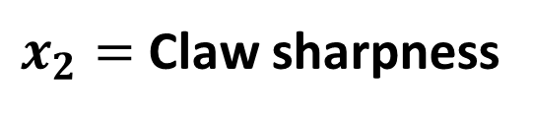
Input Layer
$x_{o}=$ Ear Length
$x_{1}=$ Snouth Length
$x_{2}=$ Claw sharpness

Slide 8
Hidden Layer
These layers perform most of the computational heavy lifting.
A neural network can have one or multiple hidden layers.
Each layer consists of units (neurons) that transform the inputs into something that the output layer can use.

Slide 9
Hidden Layer
When you build a neural network, one of the first things you decide is how many hidden layers and how many nodes go into each hidden layer.

Slide 10
Output Layer
The final layer produces that the output of the model. The format of these outputs varies depending on the specific task (e.g., classification, regression).

Slide 11
Output Layer
When you build a neural network, the number of nodes in the output depend on the number of outcomes.

Slide 12
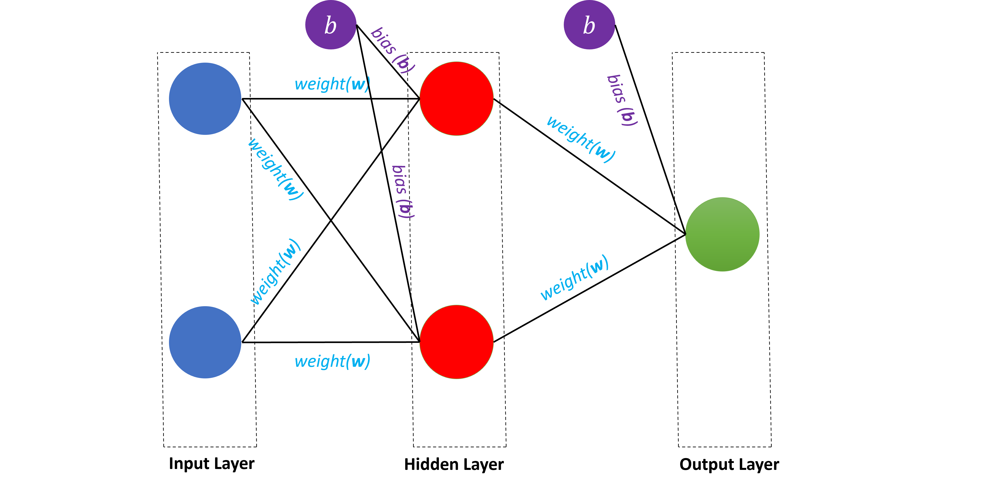
Neural Networks
Each node, or artificial neuron, connects to another and has an associated weight and threshold (bias).

Slide 13


$$b$$
$$b$$
bias (b)
weight(w)
bias (b)
weight(w)
weight(w)
bias (b)
weight(w)
weight(w)
weight(w)
Input Layer
Hidden Layer
Output Layer

Slide 14
Weights
Weights determines the neuron’s signal strength and influence. It controls how much influence each input has on the output.

Slide 15
Ear
Length
weight(w)
weight(w)
weight(w)
weight(w)
weight(w)
Sharpness of Claw
Imagine we are predicting an image if it is a Cat or Dog
weight(w)
Input Layer
Hidden Layer

Slide 16
Ear
Length
weight(w)
weight(w)
weight(w)
weight(w)
weight(w)
Sharpness of Claw
Because dogs have longer ears, the weight for Ear length has a stronger influence.
weight(w)
Input Layer
Hidden Layer

Slide 17
Ear
Length
weight(w)
weight(w)
weight(w)
weight(w)
weight(w)
Sharpness of Claw
And because cats have sharper claws, the weight for Sharpness of Claws has a stronger influence.
weight(w)
Input Layer
Hidden Layer

Slide 18
Biases
Biases are additional units that can activate neurons even if an input is zero. They are entirely separate from the network but they are not optional.
When a bias is added, even if the previous unit has a value of zero, the bias will activate a signal and push the data forward

Slide 19


$$b$$
$$b$$
bias (b)
Bark Level
bias (b)
bias (b)
Purr Level
Because dogs do not purr, adding a bias prevents neurons from producing a zero output.

Slide 20
$$b$$
$$b$$
bias (b)
Bark Level
bias (b)
bias (b)
Purr Level
And because cats do not bark, adding a bias also prevents neurons from producing a zero output.

Slide 21
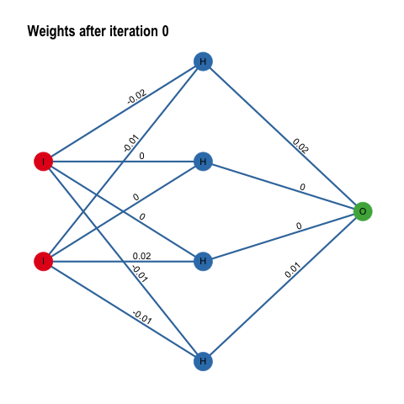
Weights and Biases are the trainable parameters that the neural network updates during training.

Slide 22
Their values adjust after each training so that the neural network can produce better predictions

Slide 23


$$b$$
$$b$$
bias (b)
Weights and Biases determine the size of the neural network.
In this example, we 6 weights and 3 biases with a total of 9 parameters.
weight(w)
bias (b)
weight(w)
weight(w)
bias (b)
weight(w)
weight(w)
weight(w)
Input Layer
Hidden Layer
Output Layer

Slide 24

Weights and Biases
1 Trillion
175 Billion
1.5 Billion
117 million
GPT-1
GPT-2
GPT-3
GPT-4
For comparison, GPT contains up to a trillion parameters

Slide 25

What is a Neural Network?
How does a Neural Network make a prediction?
How to train a Neural Network

Slide 26
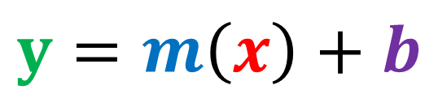
How does a Neural Network make a prediction?
Think of each individual neurons as its own linear regression model, composed of input data, weights, a bias (or threshold), and an output.
$$y=m\left(x\right)+b$$

Slide 27
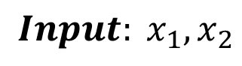
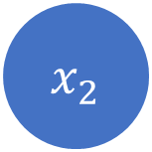

$${ x}_{1}$$
Activation function
$${Input: x}_{1},x_{2}$$
Activation function
$${ x}_{2}$$
Activation function
Input Layer
Hidden Layer
Output Layer

Slide 28

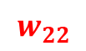



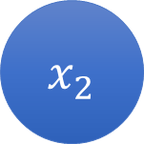


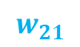
$$Weights: w_{11},w_{12} ,w_{21},w_{22},w_{3},w_{4}$$
$${ x}_{1}$$
$$w_{11}$$
Activation function
$$w_{3}$$
$$w_{12}$$
Activation function
$$w_{21}$$
$$w_{4}$$
$${ x}_{2}$$
$$w_{22}$$
Activation function
Input Layer
Hidden Layer
Output Layer

Slide 29
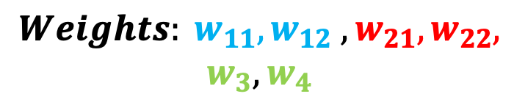

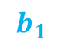

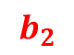

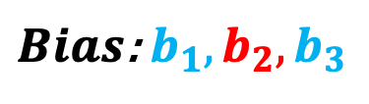
$$b$$
$$b$$
$$b_{1}$$
$$Weights: w_{11},w_{12} ,w_{21},w_{22},$$
$$w_{3},w_{4}$$
$$b_{2}$$
$${ x}_{1}$$
$$w_{11}$$
Activation function
$${ b}_{3}$$
$$b_{2}$$
$Bias$: $b_{1}, b_{2},b_{3}$
$$w_{3}$$
$$w_{12}$$
Activation function
$$w_{21}$$
$$w_{4}$$
$${ x}_{2}$$
$$w_{22}$$
Activation function
Input Layer
Hidden Layer
Output Layer

Slide 30
How does a Neural Network make a prediction?
Once an input layer is determined, weights are assigned.
These weights help determine the importance of any given variable, with larger ones contributing more significantly to the output compared to other inputs.
All inputs are then multiplied by their respective weights and then summed.

Slide 31
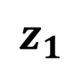
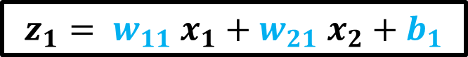
$$b$$
$$b_{1}$$
$$z_{1}$$
$$z_{1}= w_{11} x_{1}+w_{21} x_{2}+b_{1}$$
$${ x}_{1}$$
$$w_{11}$$
Activation function
Activation function
$$w_{21}$$
$${ x}_{2}$$
Activation function
Input Layer
Hidden Layer
Output Layer

Slide 32
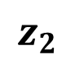
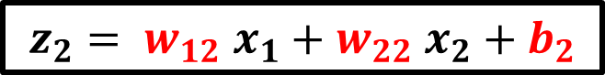
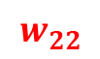
$$b$$
$$z_{1}$$
$$z_{1}= w_{11} x_{1}+w_{21} x_{2}+b_{1}$$
$$b_{2}$$
$${ x}_{1}$$
Activation function
$$w_{12}$$
Activation function
$$z_{2}$$
$${ x}_{2}$$
Activation function
$$w_{22}$$
$$z_{2}= w_{12} x_{1}+w_{22} x_{2}+b_{2}$$
Input Layer
Hidden Layer
Output Layer

Slide 33
How does Neural Networks make a prediction?
Afterward, the output is passed through an activation function, which determines the output.
If that output exceeds a given threshold, it “fires” (or activates) the neuron, passing data to the next layer in the network.
This results in the output of one node becoming in the input of the next node. This process of passing data from one layer to the next layer defines this neural network as a feedforward network.

Slide 34
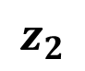
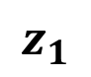
$$b$$
There are different activation functions we can use. They are:
Sigmoid
ReLU
tanH
Softmax
$$b_{1}$$
$$z_{1}$$
$$b_{2}$$
$${ x}_{1}$$
$$w_{11}$$
Activation function
$$w_{12}$$
Activation function
$$w_{21}$$
$$z_{2}$$
$${ x}_{2}$$
Activation function
$$w_{22}$$
Input Layer
Hidden Layer
Output Layer

Slide 35
$$b$$
When you build a neural network, you have to decide which activation function or functions to use.
$$b_{1}$$
$$z_{1}$$
$$b_{2}$$
$${ x}_{1}$$
$$w_{11}$$
Activation function
$$w_{12}$$
Activation function
$$w_{21}$$
$$z_{2}$$
$${ x}_{2}$$
Activation function
$$w_{22}$$
Input Layer
Hidden Layer
Output Layer

Slide 36

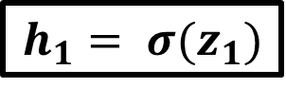
$$b$$
$$b_{1}$$
$$z_{1}$$
$$b_{2}$$
$${ x}_{1}$$
$$w_{11}$$
Activation function
$$h_{1}$$
$$h_{1}= σ(z_{1})$$
$$w_{12}$$
Activation function
$$w_{21}$$
$$z_{2}$$
$${ x}_{2}$$
Activation function
$$w_{22}$$
Input Layer
Hidden Layer
Output Layer

Slide 37
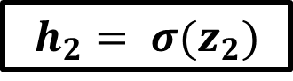


$$b$$
$$b_{1}$$
$$z_{1}$$
$$b_{2}$$
$${ x}_{1}$$
$$w_{11}$$
Activation function
$$h_{1}$$
$$h_{1}= σ(z_{1})$$
$$w_{12}$$
Activation function
$$w_{21}$$
$$z_{2}$$
$${ x}_{2}$$
Activation function
$$h_{2}$$
$$h_{2}= σ(z_{2})$$
$$w_{22}$$
Input Layer
Hidden Layer
Output Layer

Slide 38

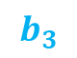
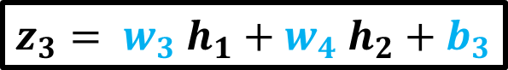

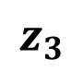

$$b$$
$$b$$
$$z_{1}$$
$${ x}_{1}$$
Activation function
$$h_{1}$$
$$b_{3}$$
$$w_{3}$$
$$z_{3}$$
Activation function
$$z_{2}$$
$$w_{4}$$
$$z_{3}= w_{3} h_{1}+w_{4} h_{2}+b_{3}$$
$${ x}_{2}$$
Activation function
$$h_{2}$$
Input Layer
Hidden Layer
Output Layer

Slide 39
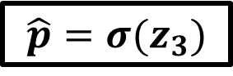


$$b$$
$$b$$
$$z_{1}$$
$${ x}_{1}$$
Activation function
$$h_{1}$$
$$b_{3}$$
$$w_{3}$$
$$z_{3}$$
Activation function
$$\hat{p}$$
$$z_{2}$$
$$\hat{p}=σ(z_{3})$$
$$w_{4}$$
$${ x}_{2}$$
Activation function
$$h_{2}$$
$\hat{p}$is the output of the neural network
Input Layer
Hidden Layer
Output Layer

Slide 40
What is a Neural Network?
How does a Neural Neural make a prediction?
How to train a Neural Network

Slide 41

Backpropagation

Slide 42


$${ x}_{1}$$
Activation function
$$\hat{p}$$
Activation function
Loss function
$${ x}_{2}$$
Activation function
Calculate Loss
Input Layer
Hidden Layer
Output Layer
FORWARD PASS (MAKE PREDICTION)

Slide 43

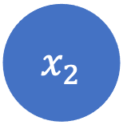
$${ x}_{1}$$
Activation function
$$\hat{p}$$
Activation function
Loss function
$${ x}_{2}$$
Activation function
Calculate Loss
Input Layer
Hidden Layer
Output Layer
BACK PROPAGATION (Adjust all weights to reduce loss)

Slide 44
Back Propagation Example

Slide 45
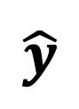
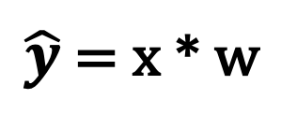
x
$$\hat{y}$$
w
$\hat{y}$ = x * w
Input Layer
Output Layer

Slide 46
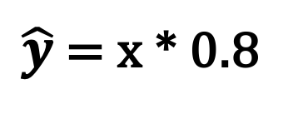
x
Let us initialize weight (w) to 0.8
$$\hat{y}$$
w = 0.8
$\hat{y}$ = x * 0.8
Input Layer
Output Layer

Slide 47
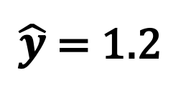
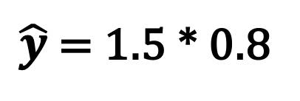
Input (x) | Actual Output (y)
1.5 | 0.5
x
$$\hat{y}$$
w = 0.8
$\hat{y}$ = 1.5 * 0.8
$\hat{y}$ = 1.2
Image if have a very simple dataset and the correct output is 0.5
Input Layer
Output Layer

Slide 48

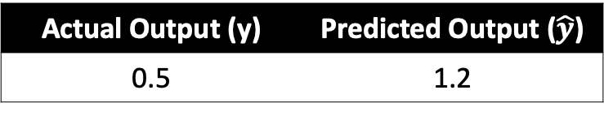
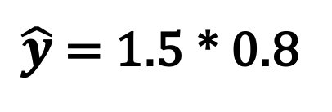
Input (x) | Actual Output (y)
1.5 | 0.5
x
$$\hat{y}$$
w = 0.8
$\hat{y}$ = 1.5 * 0.8
$\hat{y}$ = 1.2
Actual Output (y) | Predicted Output ($\hat{y}$)
0.5 | 1.2
Input Layer
And the prediction $\hat{y}$of our neural network is 1.2
Output Layer

Slide 49
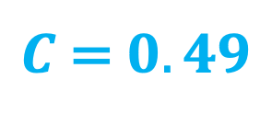
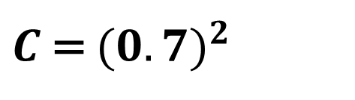
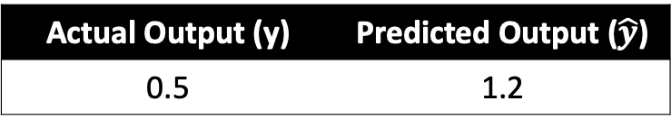
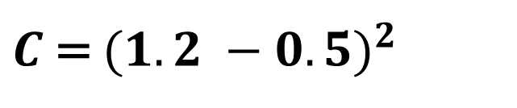
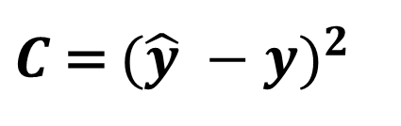
Let us use Mean Squared Error (MSE) as our cost function (C)
Actual Output (y) | Predicted Output ($\hat{y}$)
0.5 | 1.2
x
$$\hat{y}$$
w = 0.8
$C$ = ${(\hat{y} −y)}^{2}$
$C$ = ${(1.2 −0.5)}^{2}$
$C$ = ${(0.7)}^{2}$
$C$ = $0.49$
Input Layer
Using a cost function, this tells us how far we are from the correct answer
Output Layer

Slide 50
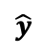
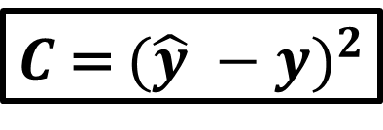
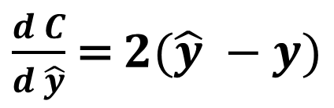
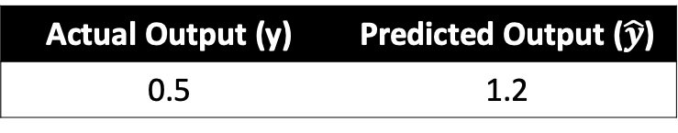
x
$$\hat{y}$$
w = 0.8
Loss
Input Layer
Output Layer
Actual Output (y) | Predicted Output ($\hat{y}$)
0.5 | 1.2
$C$ = ${(\hat{y} −y)}^{2}$
Weight
$\frac{d C}{d \hat{y}}$ = $2(\hat{y} −y)$
During training, backpropagation uses this loss/error from the cost function to adjust the weights of our neural network

Slide 51
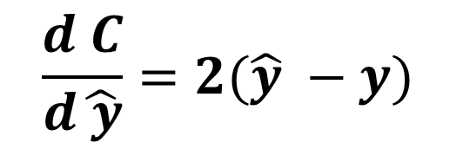
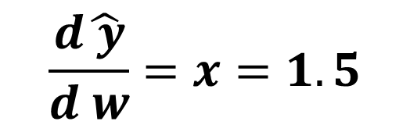
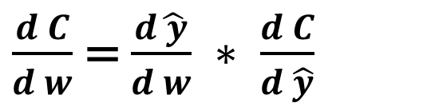
x
$$\hat{y}$$
w = 0.8
Loss
Input Layer
Output Layer
$\frac{d C}{d w}$ = $\frac{d\hat{ y}}{d w} ∗ \frac{d C}{d \hat{y}}$
$$\frac{d\hat{ y}}{d w}=x=1.5$$
Weight
$$\frac{d C}{d\hat{ y}}=2(\hat{y} −y)$$

Slide 52











x
$$\hat{y}$$
w = 0.8
Loss
Input Layer
Output Layer
$\frac{d C}{d w}$ = $\frac{d\hat{ y}}{d w} ∗ \frac{d C}{d \hat{y}}$
$$\frac{d\hat{ y}}{d w}=x=1.5$$
$$\frac{d C}{d\hat{ y}}=2(\hat{y} −y)$$
Weight
$\frac{d C}{d w}$ = 1.5 $∗2 \left(\hat{y} −y\right)=\text{4.5 }∗w −1.5$

Slide 53



x
$$\hat{y}$$
w = 0.8
Loss
Input Layer
Output Layer
$$Putting it all together:$$
Reduce the weight by learning rate $α$ multiplied by the gradient
Weight
$w^{′}=w −α$ $\frac{d C}{d w}$
$$w^{′}=w −0.1∗(4.5 w −1.5)$$

Slide 54

x
$$\hat{y}$$
w = 0.8
Loss
Input Layer
Output Layer
w | $$w^{′}$$
0.8 | 0.59
0.59 | 0.4745
0.4745 | 0.410975
0.410975 | 0.37603625
0.3760325 | 0.3568199375
0.3333
Weight

Slide 55













$$y_{4}$$
$y_{3}=w_{3} ∗y_{4}$
$y_{2}=w_{2} ∗y_{3}$
$y_{1}=w_{1} ∗y_{2}$
$y_{0}=w_{0} ∗y_{1}$
$$w_{3}$$
$$w_{2}$$
$$w_{1}$$
$$w_{0}$$
$−α$ $\frac{d{ y}_{0}}{d{ w}_{0}}\frac{d C}{d{ y}_{0}}$
$$−α\frac{d{ y}_{1}}{d{ w}_{1}}\frac{d{ y}_{0}}{d{ y}_{1}}\frac{d C}{d{ y}_{0}}$$
$$−α\frac{d{ y}_{2}}{d{ w}_{2}}\frac{d{ y}_{1}}{d{ y}_{2}}\frac{d{ y}_{0}}{d{ y}_{1}}\frac{d C}{d{ y}_{0}}$$
$$−α\frac{d{ y}_{3}}{d{ w}_{3}}\frac{d{ y}_{2}}{d{ y}_{3}}\frac{d{ y}_{1}}{d{ y}_{2}}\frac{d{ y}_{0}}{d{ y}_{1}}\frac{d C}{d{ y}_{0}}$$

Slide 56


$$y_{4}$$
$y_{3}=w_{3} ∗y_{4}$
$y_{2}=w_{2} ∗y_{3}$
$y_{1}=w_{1} ∗y_{2}$
$y_{0}=w_{0} ∗y_{1}$
$$w_{3}$$
$$w_{2}$$
$$w_{1}$$
$$w_{0}$$
For example, we adjust $w_{3}$ as follows:
$w_{3}^{′}=w_{3}−α ∗y_{4}∗w_{2}∗w_{1} ∗w_{0} ∗2 (y_{0} −y)$
$$−α\frac{d{ y}_{3}}{d{ w}_{3}}\frac{d{ y}_{2}}{d{ y}_{3}}\frac{d{ y}_{1}}{d{ y}_{2}}\frac{d{ y}_{0}}{d{ y}_{1}}\frac{d C}{d{ y}_{0}}$$

